Slide 1

HI!

Slide 2
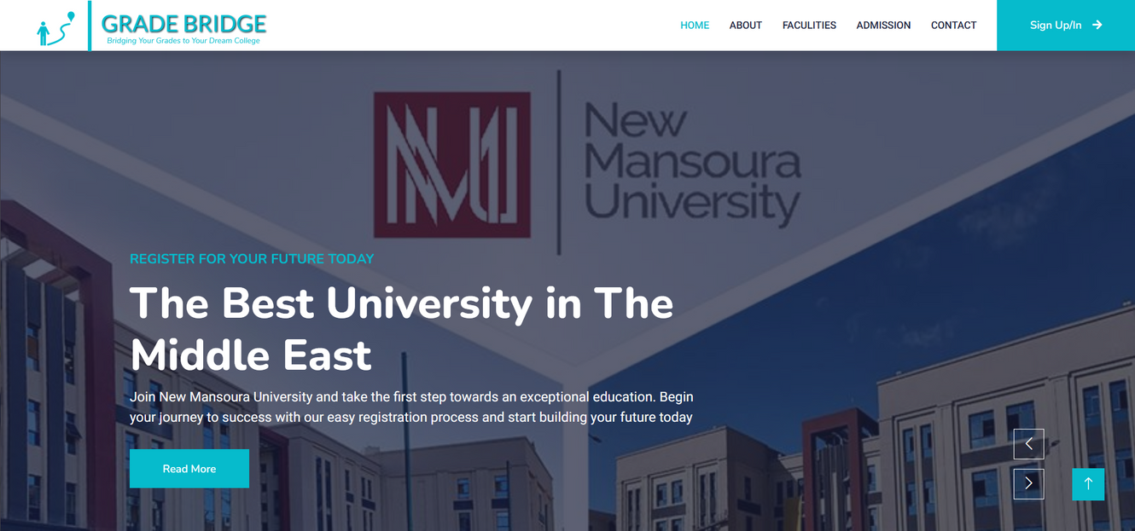

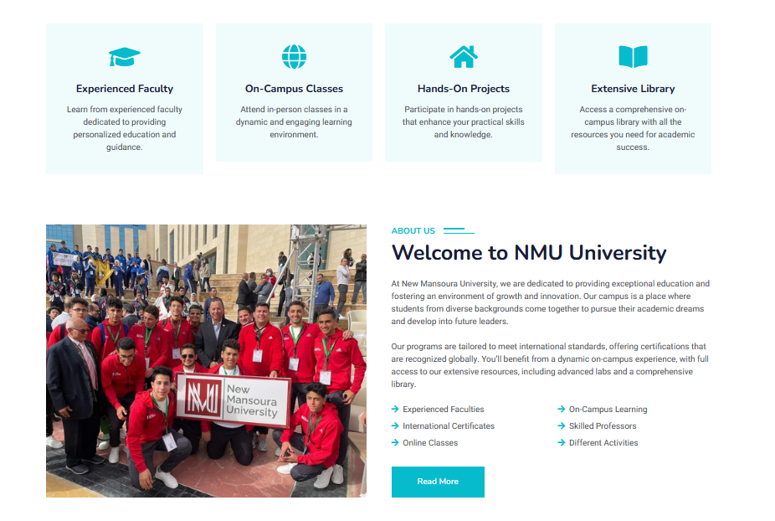
Grade Bridge
Bridging Your Grades To Your Dream College

Slide 3





TEAM
Muhammed Usama
Mustafa Mahmoud
Yara
Mohammed
Abdullah Aboshosha
Youssef
Awad

Slide 4
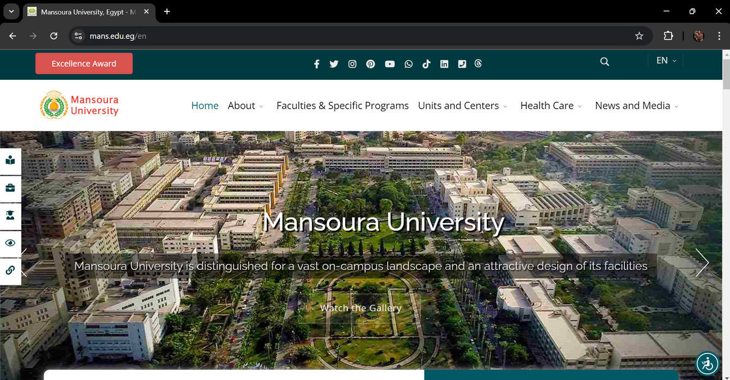
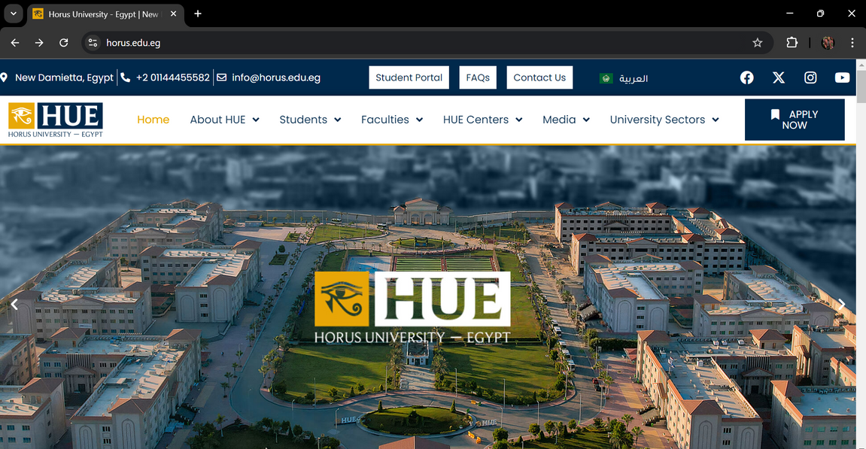
Problem?
The process of selecting a university faculty or department is complex, time-consuming, and error-prone. Students must navigate multiple university websites, compare varying admission criteria, and often make decisions without reliable information or guidance. This leads to confusion, missed opportunities, and overwhelming stress, particularly in regions with less digitized systems where students must visit universities in person. The lack of up-to-date information further complicates the process, resulting in poor decision-making and overcrowded university offices.

Slide 5

PROJECT OBJECTIVES
Providing Personalized Recommendations
Automating Faculty Selection
The platform automatically matches students’ grades with eligible faculties, eliminating the need for manual research and ensuring accurate results based on real-time data.
Grade Bridge offers tailored faculty suggestions based on a student’s grades and preferences, helping them find the best academic fit for their strengths and interests.
Reducing Overcrowding and System Failures
Enhancing Accessibility for All Students
By moving the application process online, the platform reduces physical crowding at universities and ensures stable performance during high-demand periods.
The platform is designed for easy use across different regions and educational backgrounds, including support for multiple languages, ensuring access for all students.

Slide 6
Solution
Grade Bridge is a web-based platform designed to simplify the faculty selection process for students by automating and centralizing university admissions. The platform allows students to input their grades and receive a tailored list of eligible faculties based on up-to-date admission criteria. This eliminates the need for manual research, reduces overcrowding and system overloads, and ensures that students receive accurate, personalized recommendations. Grade Bridge provides an accessible, user-friendly solution that empowers students to make informed decisions, enhancing the overall experience of transitioning to higher education.

Slide 7

KEY FEATURES
Automated Faculty Matching
Personalized Faculty Recommendations
Real-Time Admission Criteria Updates
Students can input their grades, and the system automatically generates a list of faculties where they meet the admission criteria, reducing manual effort and errors.
Based on the student’s academic performance and preferences, the platform offers personalized suggestions to help them find the best-fit faculty or program.
The platform provides up-to-date admission requirements from various universities, ensuring that students always have accurate information for their applications.
Centralized University Information Hub
Online Registration and Application Submission
Multi-Language Support
Students can access comprehensive details about multiple universities, faculties, programs, and admission guidelines all in one place, simplifying research and decision-making.
The platform allows students to complete their entire registration and application process online, eliminating the need for in-person visits and paperwork.
To accommodate students from different linguistic backgrounds, the platform offers multi-language options, enhancing accessibility for a wider audience.

Slide 8




TECKNOLOGIES

Slide 9
IMPLEMENTATION PLAN?

Slide 10
Research and Planning
Design and Prototyping
Back-End Development
Objective: Set up the server, databases, and develop the logic for student registration, grade input, and faculty matching algorithms.
Deliverables: Functional back-end system, database architecture, API for connecting the front-end.
Objective: Create wireframes, design the user interface (UI), and prototype key pages (registration, faculty matching, etc.).
Deliverables: Low-fidelity wireframes, UI designs, clickable prototype for testing user flow.
Objective: Understand user needs, gather university admission criteria, and research technical requirements.
Deliverables: Project requirements document, user personas, technical stack selection.

Slide 11
Front-End Development
Launch and Deployment
Testing and QA
Objective: Develop the user-facing components, integrate with the back-end, and ensure responsiveness across devices.
Deliverables: Fully developed front-end with a responsive UI, connected to the back-end for live data retrieval.
Objective: Conduct thorough testing for functionality, usability, and security; perform load tests to ensure system stability during peak usage.
Deliverables: Bug-free platform, test reports, optimized performance metrics.
Objective: Deploy the platform to a live environment and ensure smooth operation; offer user training if necessary.
Deliverables: Live, fully functional platform, documentation for users and administrators.

Slide 12
Challenges and Risk Management?

Slide 13
Data Inaccuracy from Universities
System Overload During Peak Times
Security and Data Privacy Concerns
Challenge: University admission criteria may change frequently, leading to outdated or inaccurate data on the platform.
Risk Management: Implement real-time data synchronization with universities and regularly update the database. Also, ensure there are clear communication channels with universities for timely updates.
Challenge: Handling sensitive student data (grades, personal information) poses security risks.
Risk Management: Implement strong encryption, secure authentication, and data privacy protocols (e.g., GDPR compliance). Regularly conduct security audits and use secure hosting services.
Challenge: High volumes of traffic during admission periods could lead to system crashes or slow performance.
Risk Management: Use scalable cloud infrastructure to handle peak loads and conduct load testing to ensure the platform can manage heavy traffic smoothly.

Slide 14
User Adoption and Resistance to Change
Budget and Time Constraints
Technical Integration with University Systems
Challenge: Students and universities may be reluctant to adopt the new system due to familiarity with traditional methods.
Risk Management: Provide training sessions, tutorials, and a user-friendly interface to ease the transition. Offer support services and educational campaigns to demonstrate the benefits of the platform.
Challenge: Unforeseen technical challenges or scope creep could lead to delays or cost overruns.
Risk Management: Use an agile development approach to prioritize essential features, regularly review progress, and manage the scope effectively. Have a contingency budget and timeline to accommodate unexpected issues.
Challenge: Difficulty in integrating the platform with various university systems for automated data retrieval.
Risk Management: Plan for API development and ensure compatibility with multiple systems. Collaborate with universities' IT departments early on to align on technical requirements and integration methods.

Slide 15
BENIFITS?

Slide 16

Streamlined Student Registration Process
Outcome: Students can easily input their grades and receive instant faculty recommendations, reducing time spent on manual research.
Benefit: This saves students time and effort while making the entire application process more efficient.
Increased Accessibility to University Information
Outcome: A centralized platform provides up-to-date information on admission criteria for multiple universities.
Benefit: Students can make well-informed decisions about where to apply without having to visit multiple university websites or campuses.
Reduced Physical Overcrowding at Universities
Outcome: By offering a fully online registration and selection process, the need for in-person visits to universities is minimized.
Benefit: This reduces long queues, relieves pressure on university staff, and enhances the overall student experience.

Slide 17
Improved Accuracy in Faculty Selection
Outcome: Automated matching of grades with admission criteria reduces the likelihood of errors in faculty selection.
Benefit: Students avoid applying to faculties where they don’t meet the criteria, saving time and reducing frustration.
Enhanced Decision-Making for Students
Outcome: With personalized recommendations and accurate, real-time data, students are empowered to make informed decisions about their academic future.
Benefit: This increases the likelihood of students being admitted to faculties where they are most likely to succeed.
Increased Efficiency for Universities
Outcome: Universities can manage registrations and applications more efficiently, reducing administrative burdens.
Benefit: This leads to fewer delays and errors in processing applications, improving overall operations during peak admission periods.

Slide 18
Lets Talk Business!

Slide 19
Customer Segments
Primary Users:
High School Graduates
Students Seeking University Admission
Secondary Users:
Educational Institutions (Private Universities, ETC...)

Slide 20
Value proposition
Simplifies the process of faculty selection by providing tailored faculty recommendations based on student grades.
Reduces the manual effort and complexity involved in applying to universities.
Offers students a user-friendly, accessible, and efficient platform for making critical educational decisions.
Provides universities with potential students who are a good match for their programs, facilitating easier admissions

Slide 21
Channels
Website: Primary platform for accessing the Grade Bridge service.
Social Media: Engaging students through platforms such as Instagram, Facebook, and Twitter to raise awareness.
University Fairs: Physical or virtual participation in student counseling events and university fairs to reach potential users

Slide 22
Customer Relationships
Self-service: The platform allows students to independently input their grades and receive faculty recommendations.
Support Services: Offering customer support through live chat, email, and help center to resolve user queries and issues.
Community Engagement: Building an online community through forums and social media to encourage peer-to- peer support among students

Slide 23
Revenue Streams
Costs associated with web hosting, software development, and platform maintenance.
Marketing expenses for user acquisition campaigns and university partnerships.
Data acquisition costs for maintaining accurate and updated faculty and admission criteria information.
Salaries for the development, marketing, and support teams.
Freemium model: Core features of the platform are offered for free to all students, while premium features such as personalized counseling, detailed faculty comparisons, and career advice are offered for a fee.
Advertisements: Monetization through relevant ads from educational institutions, private universities, and

Slide 24
Key Resources
Skilled development team to manage the technical aspects of the platform.
Access to up-to-date data on faculties, admission criteria, and grading systems.
Strong partnerships with universities
and educational organizations to provide verified data and increase user trust.
Marketing and sales teams to handle promotions and collaborations with institutions.

Slide 25
Key Activities
Development and maintenance of the Grade Bridge platform, ensuring its functionality and scalability.
Continuous updating of faculty data and eligibility criteria to ensure accuracy.
User acquisition strategies through marketing campaigns targeted at students and educational institutions.
Building partnerships with universities and private educational organizations. for potential collaborations.

Slide 26
Key Partnerships
1.Educational Institutions:
Universities and Colleges: Provide accurate faculty and admission data to ensure up-to-date recommendations.
High Schools: Promote the platform to students during the application process.
2.Government Bodies:
Ministry of Education: Ensure compliance with policies and access
official data. Accreditation Agencies: Verify the authenticity of faculty information.

Slide 27
Key Partnerships
3.Technology Partners:
Web Hosting and Data Security Firms: Ensure platform reliability, scalability, and data protection.
Payment Gateways: Facilitate secure transactions for premium features.
Marketing and Outreach Partners:
Education Consultants and Influencers: Promote the platform through expert services and social
media outreach. Advertising Networks: Target high school students with focused marketing. Private Sector and NGOs:
Scholarship Foundations: Integrate scholarship opportunities for eligible students.
Corporate Sponsors: Offer internships and career opportunities for students

Slide 28
Cost Structure
Costs associated with web hosting, software development, and platform maintenance.
Marketing expenses for user acquisition campaigns and university partnerships.
Data acquisition costs for maintaining accurate and updated faculty and admission citeria information.
Salaries for the development, marketing, and support teams.

Slide 29


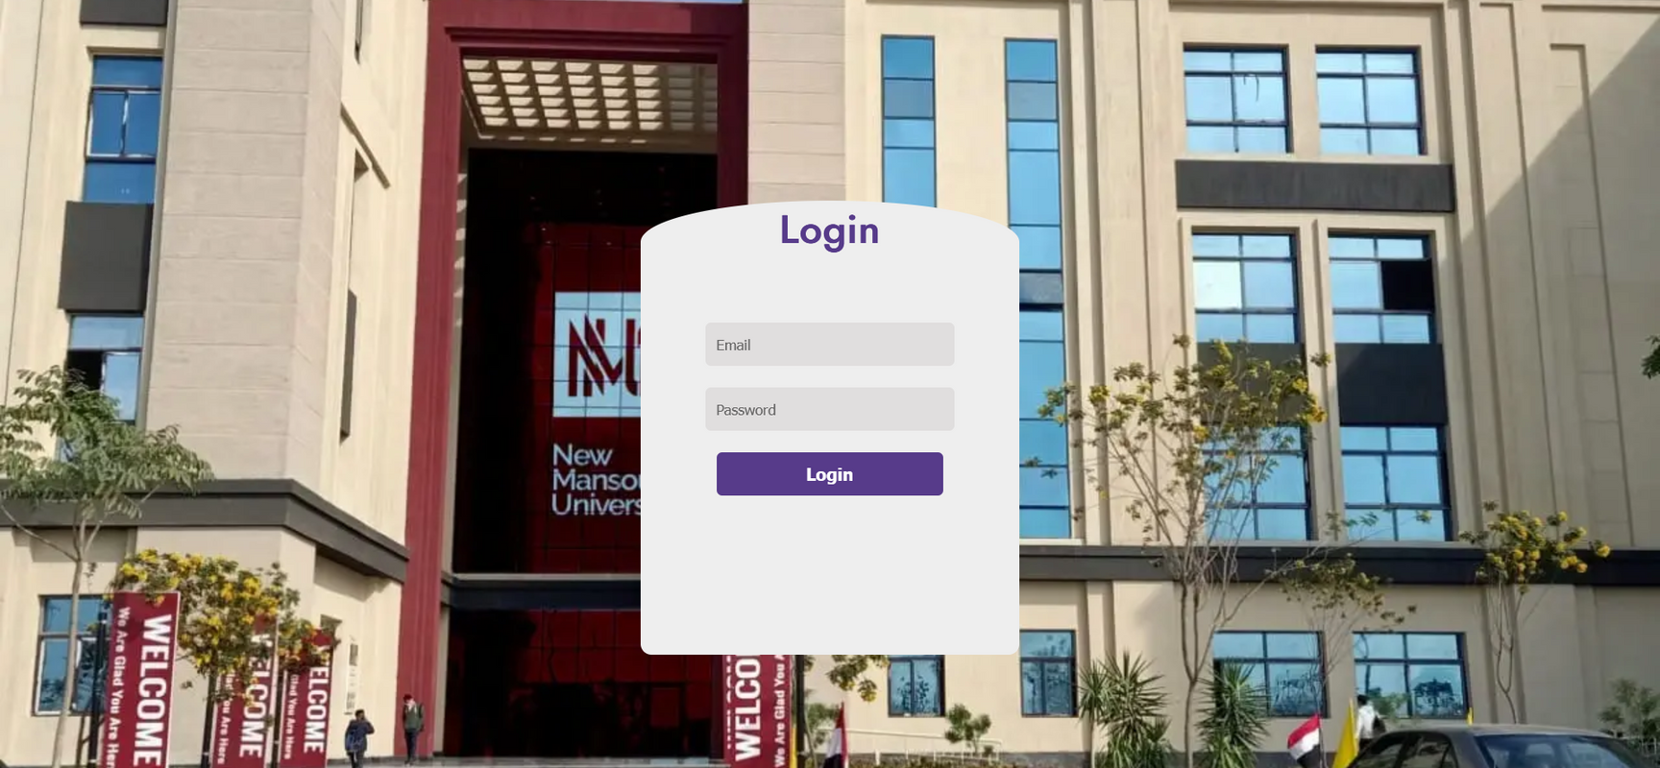
Conclusion
The college registration platform addresses key challenges in the university admission process by simplifying faculty selection, automating eligibility matching, and providing real-time information. It reduces the burden on students and universities alike, offering a centralized, accessible, and efficient system. By streamlining the registration process, the platform enhances decision-making, eliminates manual errors, and reduces physical overcrowding during peak periods. Ultimately, it empowers students to make informed academic choices, paving the way for their success in higher education.

Slide 30
Live Demo
addmission.great-site.net

Slide 31
QUESTIONS?

Slide 32
THANKS

